Slide 1
MATHEMATICAL EXPECTATION

Slide 2
MATHEMATICAL EXPECTATION
OBJECTIVES
the students are expected to:
  solve for the mean and variance of a random variable X.
  relate the statistics to probability by identifying the mean and variance as connected to the probability.

Slide 3
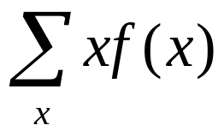
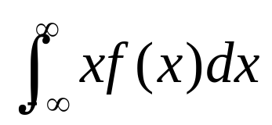
MEAN OF A RANDOM VARIABLE
Let X be a random variable with probability distribution f(X). The mean
or expected value of X is
μ = E(X) =
if X is discrete, and
μ = E(X) =
if X is continuous
for all (x,y) within their range

Slide 4
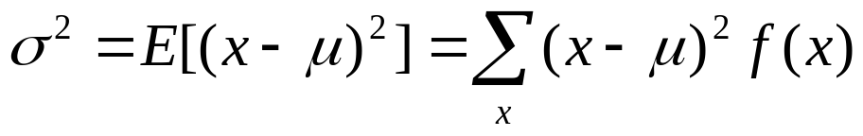
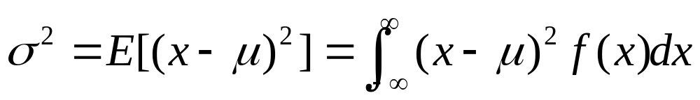
VARIANCE OF RANDOM VARIABLE
Let X be a random variable with probability distribution f(x) and mean μ.
The variance of X is
if X is discrete, and
if X is continuous.
The positive square root of the variance, σ, is called the standard deviation.
σ² = E(x²) - μ²

Slide 5
MATHEMATICAL EXPECTATION
DISCRETE
1. A sample of 3 items is selected at random from a box containing 20 items of which 4 are defective. Find the expected number of defective items in the sample.

Slide 6
MATHEMATICAL EXPECTATION
DISCRETE
2. In a gambling game a player is paid PHP 10 if he draws a jack or a queen and PHP 15 if he draws a king or an ace from an ordinary deck of 52 playing cards. If he draws any other card, he losses. How much should he pay to play if the game is fair?

Slide 7
MATHEMATICAL EXPECTATION
DISCRETE
3. Suppose that the probabilities are 0.4, 0.3, 0.2, 0.1, respectively, that 0, 1, 2, or 3 power failure will strike a certain subdivision in any given year. Find the mean and variance of the random variable X, representing the number of power failures striking this subdivision.

Slide 8
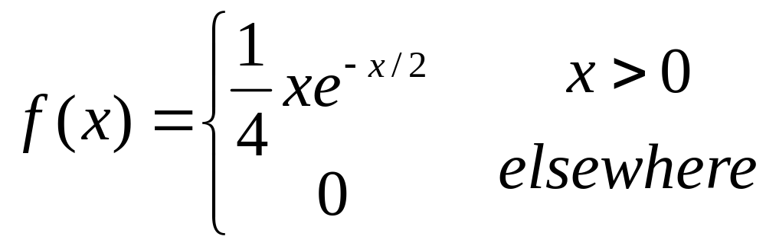
MATHEMATICAL EXPECTATION
CONTINUOUS
1. Compute the expected value of X if X has a density function given by

Slide 9
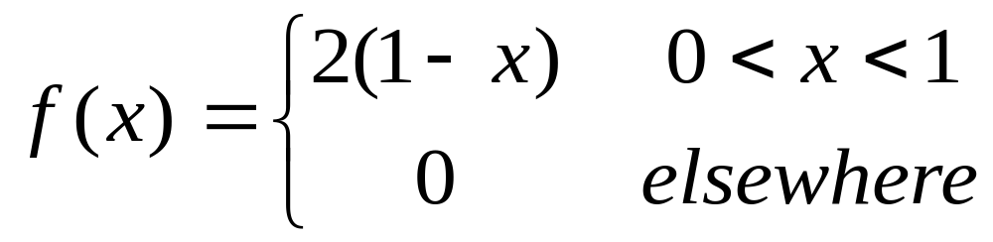
MATHEMATICAL EXPECTATION
CONTINUOUS
2. If a dealer’s profit in units of PHP 250,000, on a new automobile can be looked upon as a random variable X as having the density function
Find the average profit per automobile.

Slide 10
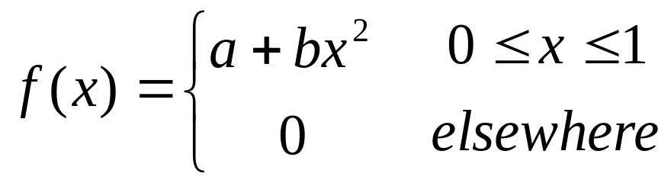
MATHEMATICAL EXPECTATION
CONTINUOUS
3. The density function of X is given by
If E(x) = 3/5, find a, b.

Slide 11
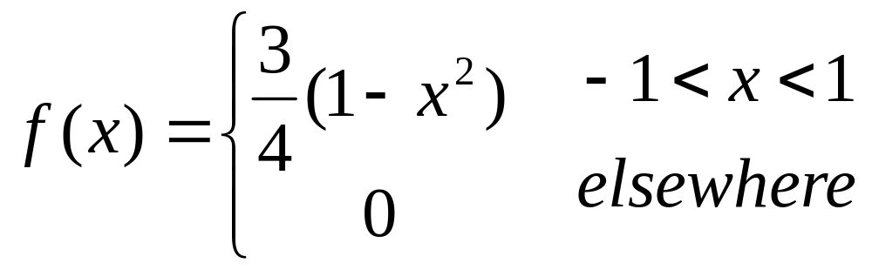
VARIANCE OF RANDOM VARIABLE
Suppose the density function of X is given by
Find the mean and variance of X.

